Slide 1
Distributed Systems
Distributed Resource Management: Mechanisms for Building Distributed File System
by
Ms. Neha Shukla
(B.Tech, M.Tech, Ph.D*)
CSE Department
KIET Group of Institutions

Slide 2
Contents
Distributed File System (DFS)
Architecture of DFS
Mechanisms to Build DFS

Slide 3
Distributed File System (DFS)
A distributed file system is a resource management component of a distributed operating system. It implements a common file system that can be shared by all the autonomous computers in the system.
Two important goals :
1. Network transparency – to access files distributed over a network. Ideally, users do not have to be aware of the location of files to access them.
2. High Availability - to provide high availability. Users should have the same easy access to files, irrespective of their physical location.

Slide 4
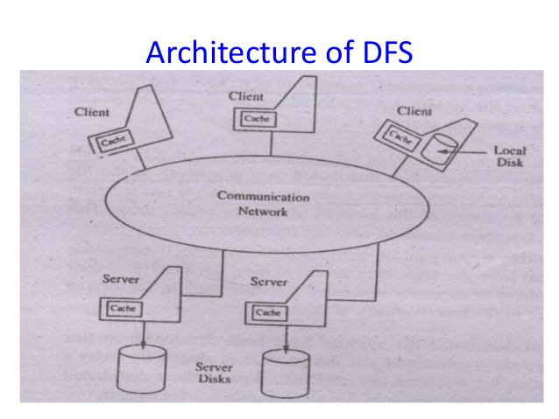

Slide 5
Architecture of DFS
In a distributed file system, files can be stored at any machine and the computation can be performed at any machine.
The two most important services present in a distributed file system are the name server and cache manager
A name server is a process that maps names specified by clients to stored objects such as files and directories
A cache manager is a process that implements file caching
The mapping (also referred to as name resolution) occur when a process references a file or directory for the first time

Slide 6
In file caching, a copy of data stored at a remote file server is brought to the client’s machine when referenced by the client.
Cache managers can be present at both clients and file servers.
Cache managers at the servers cache files in the main memory to reduce delays due to disk latency.
If multiple clients are allowed to cache a file and modify it, the copies can become inconsistent.
To avoid this inconsistency problem, cache managers at both servers and clients coordinate to perform data storage and retrieval operations.

Slide 7
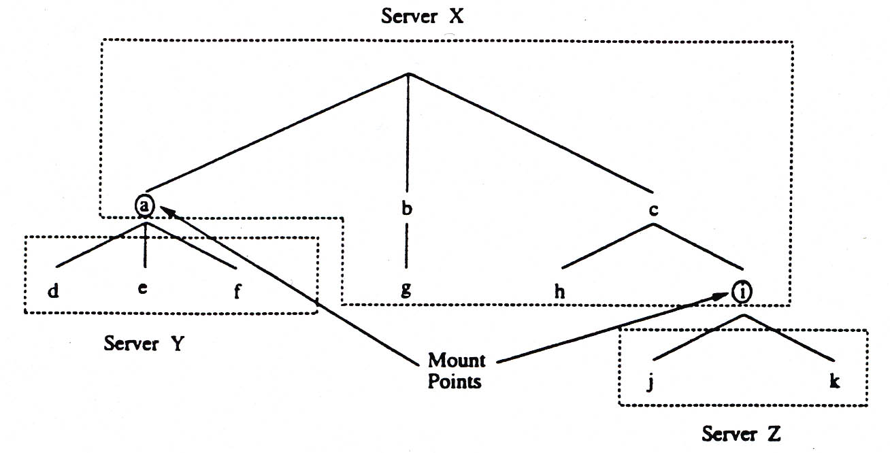
Mechanisms used in distributed file systems
Mounting
  The mount mechanism binds together several filename spaces (collection of files and directories) into a single hierarchically structured name space (Example: UNIX and its derivatives)
  A name space ‘A’ can be mounted (bounded) at an internal node (mount point) of a name space ‘B’
  Implementation: kernel maintains the mount table, mapping mount points to storage devices

Slide 8
Mechanisms used in distributed file systems (cont.)
(1) Mounting (cont.)
  Location of mount information
    a. Mount information maintained at clients
      Each client mounts every file system
      Different clients may not see the same filename space
      If files move to another server, every client needs to update its mount table
      Example: SUN NFS
    b. Mount information maintained at servers
      Every client see the same filename space
      If files move to another server, mount info at server only needs to change
      Example: Sprite File System

Slide 9
Mechanisms used in distributed file systems (cont.)
(2) Caching
  Improves file system performance by exploiting the locality of reference
  When client references a remote file, the file is cached in the main memory of the server (server cache) and at the client (client cache)
  When multiple clients modify shared (cached) data, cache consistency becomes a problem
  It is very difficult to implement a solution that guarantees consistency
(3) Hints
  Treat the cached data as hints, i.e. cached data may not be completely accurate
  Can be used by applications that can discover that the cached data is invalid and can recover
    Example:
      After the name of a file is mapped to an address, that address is stored as a hint in the cache
      If the address later fails, it is purged from the cache
      The name server is consulted to provide the actual location of the file and the cache is updated

Slide 10
Mechanism used in distributed file systems (cont.)
(4) Bulk data transfer
  Observations:
    Overhead introduced by protocols does not depend on the amount of data transferred in one transaction
    Most files are accessed in their entirety
  Common practice: when client requests one block of data, multiple consecutive blocks are transferred
(5) Encryption
  Encryption is needed to provide security in distributed systems
  Entities that need to communicate send request to authentication server
  Authentication server provides key for conversation

Slide 11
Thank
You

